Slide 1
php
A small revision

Slide 2
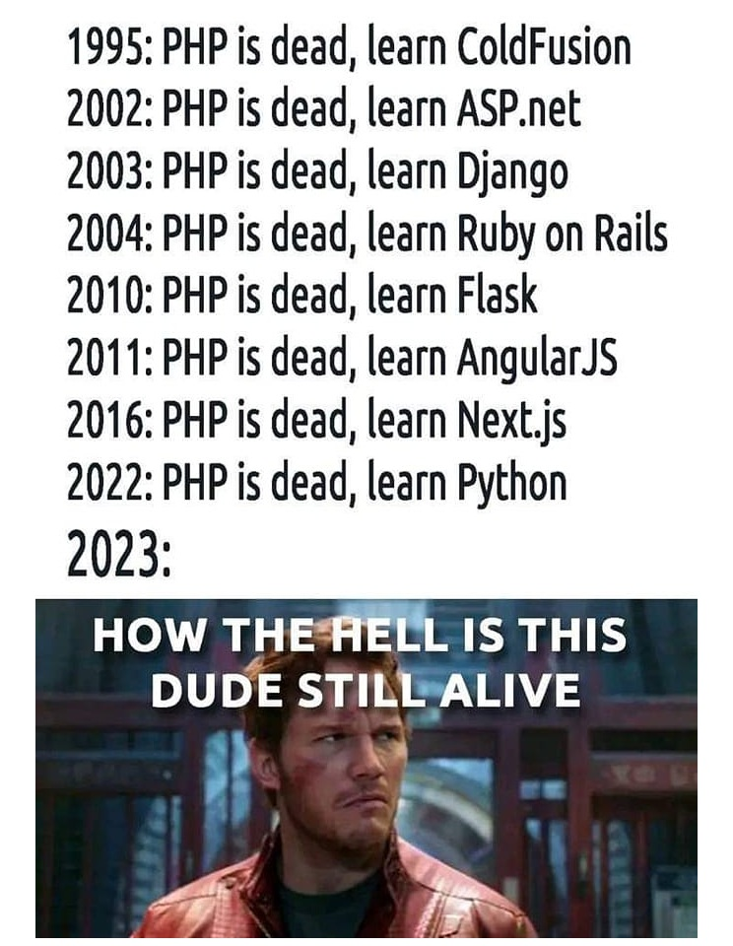

Slide 3
Server-Side Scripting
It is a programming language designed to be executed on a web server to handle data processing, interact with databases, and generate dynamic content that is sent to the client's web browser. It enables web developers to perform complex tasks on the server, such as user authentication, database management, and business logic, while delivering the final output to the client-side for display. Unlike client-side scripting languages, server-side scripts remain hidden from the end-user, providing more security and control over sensitive operations.

Slide 4
Aspect | Client-Side Scripting Language | Server-Side Scripting Language
Execution Location | Executed in the user's browser | Executed on the web server
Purpose | Enhance interactivity and user experience on the client side (browser) | Handle server-side tasks and data processing
Accessibility | Available to the client (user) | Hidden from the client (user)
Language Examples | JavaScript, HTML, CSS | PHP, Python, Ruby, Node.js, Java, ASP.NET, etc.
Dependency on Network | Minimal dependence on network (for initial page load) | Highly dependent on network for data processing and database access
Security | Can be easily manipulated and should not be trusted for sensitive operations | More secure, as sensitive operations are handled on the server and not exposed to the client
User Experience | Faster response times and immediate feedback to users | May lead to longer response times due to server processing
Examples of Usage | Form validation, animations, client-side form processing | User authentication, database management, server tasks, generating dynamic content

Slide 5
Websites based on php
Facebook
Flipkart
Wikipedia
Wordpress
Flickr

Slide 6
php.ini "C:\xampp\php\php.ini"
The purpose of the "php.ini" file is to configure and customize the behavior of PHP on a web server.

Slide 7
Htdocs Folder "C:\xampp\htdocs"
The "htdocs" folder (or sometimes called "public_html" or "www" folder) serves a specific purpose in web server configurations. Its primary purpose is to store and serve the files that make up the website's publicly accessible content. When a user makes a request to access a website hosted on the server, the web server looks into the "htdocs" folder to find the requested files and serves them back to the user's browser.

